Slide 1



The State of Inclusion in KY
HDI -University of Kentucky
Updated 2019
educate.advocate.innovate
Notes:
You won't need to record this, we will have it typed on the lesson page.

Slide 2



Agenda
IDEA, ADA, and LRE
The state of inclusion in KY
Video Perspectives
Thasya
Dan Habib
The Henderson School
Notes:
You won't need to record this, we will have it typed on the lesson page.

Slide 3

OLMSTEAD under ADA
Title II: no qualified individual with a disability shall by reason of such disability be excluded from participation in or be denied the benefits of the services, programs, or activities of a public entity, or be subjected to discrimination of any such entity….. (Kanter, 2017)

Slide 4
IDEA Requires
Section 300.114, requires each public agency to ensure that, to the maximum extent appropriate, children with disabilities are educated with children who are not disabled.
The removal of children with disabilities from the regular educational environment occurs only when the nature or severity of the disability is such that the education in regular classes with the use of supplementary aids and services cannot be achieved satisfactorily.

Slide 5
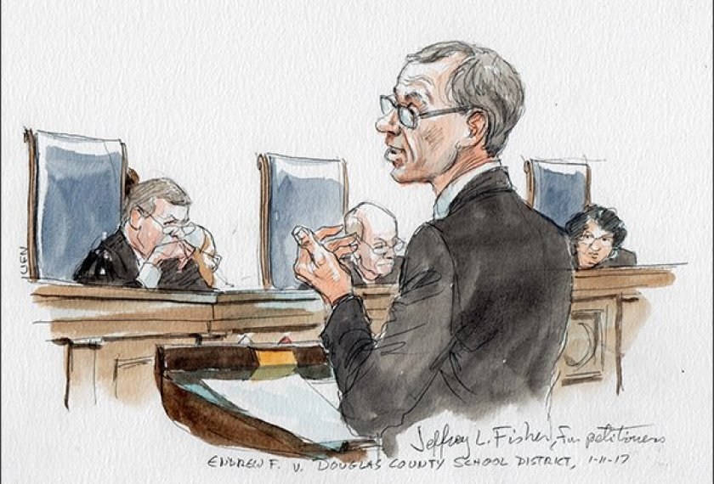

Two New Court Cases
Endrew F. vs Douglas County Public Schools (2017)
Supreme Court Decision
More than minimum progress is expected
6th Circuit Court of Appeals upheld the
Least Restrictive Environment in
L.H. Vs. Hamilton County TN Public Schools (2018)
Notes:
1 p

Slide 6
So…. If IDEA says that…. Then…
Have you seen inclusive education practiced in schools?
Why do you think the segregation of students with intellectual and multiple disabilities continues?
What do we know about outcomes for students with significant disabilities who are segregated?

Slide 7
Evidence Based ….
Schools implementing a school wide model of equity-based inclusive education demonstrated larger student growth on annual state reading and math assessments relative to students attending comparable schools (Choi, Meisenheimer, McCart, & Sailor, 2016).
Students without disabilities made significantly greater progress in reading and math when educated in inclusive classrooms (Cole, Waldron, & Majd, 2004).
Likewise, engagement in the general education curriculum strongly and positively correlated with math and reading achievement for students with disabilities (Cole, et al., 2004; Cosier, Causton-Theoharis, & Theoharis, 2013; Kurth & Mastergeorge, 2010; Sermier Dessemontet, Bless, & Morin, 2012).
The inclusion of students with disabilities in general education produced either positive or neutral effects on outcomes for their non-disabled classmates (Kalambouka, Farrell, Dyson, & Kaplan, 2007; Ruijs & Peetsma, 2009; Ruijs, Van der Veen, & Peetsma, 2010; Sermier Dessemontet & Bless, 2013).
Inclusion, peer support, team collaboration and training are the best predictors of AAC use among students who need communication supports (Kleinert, Kearns et. al 2019)
http://www.swiftschools.org/sites/default/files/Research%20Support%20for%20SWIFT%202017.pdf

Slide 8
The “State” of Inclusion in KY
30 years of inclusive preschool programs
25 years of collaborative co-teaching models for high incidence students
Peer support and peer networks across the state
Only 1 segregated school for children with intellectual disabilities in one district in the whole state.

Slide 9

2017-2018 KY Child Count Data
Children aged 6 - 21
(Dec. 1, 2017)

Slide 10
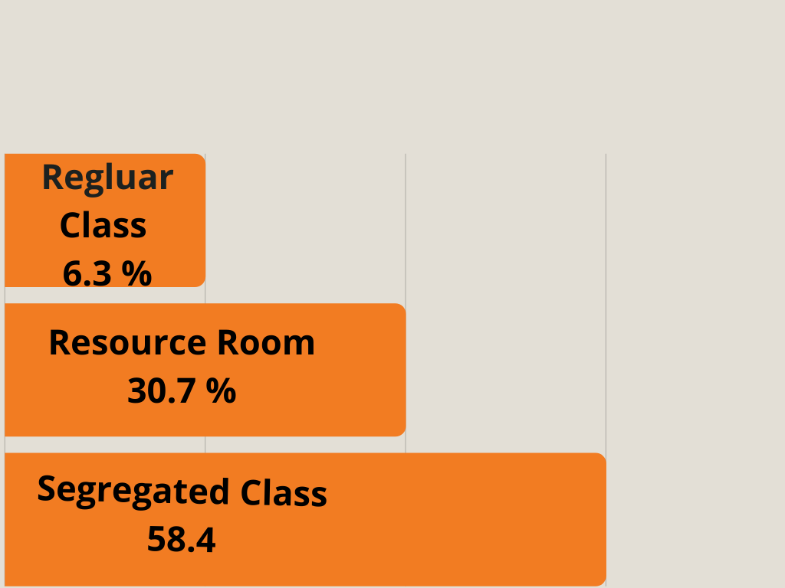
KY Data for Students with MSD
While these LRE figures for all students with disabilities compare favorably to national LRE data.
Students with the most severe disabilities are still served, for the most part, in separate class placements in KY.

Slide 11
YET EVEN FOR STUDENTS WITH MORE SIGNIFICANT DISABILITIES, KY IS MORE INCLUSIVE THAN MANY OTHER STATES…
In a 15 state survey of teachers, Kleinert et al. (2015) identified the educational placements of 39,837 students with significant cognitive disabilities participating in their respective state alternate assessments.
92% of students were served primarily in self-contained classrooms or separate schools,
Only 7% were served in regular education or resource room placements (compared to 37% of students labelled FMD served in regular classrooms/resource rooms in KY in 2017-2018)

Slide 12
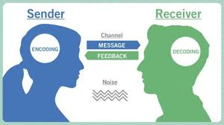
The Benefits to Inclusive Education
Curriculum access
Social/emotional connection opportunities
Communication models and supports
Health and Safety

Slide 13
Inclusive Education in KY
While KY is ahead of many states, we still need to build capacity to
Increase the inclusion of children with M S Disabilities in general education classes.
Create supports for membership, belonging, social/emotional development in partnership collaborative partnerships in general education classes.
Reduce to 0 the number students who come to preschool and kindergarten without communication, or leave high school without communication.

Slide 14

What are we waiting for?

Slide 15
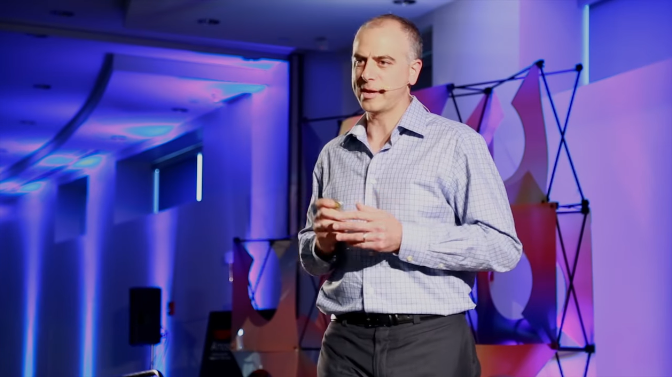
Let’s Watch
This film is a TED talk by Dan Habib, a film-maker and Samuel’s dad.
What are your best memories of school?
Given the social and community opportunities that schools provide….
Why does inclusive education matter?

Slide 16
https://www.youtube.com/watch?v=izkN5vLbnw8

Slide 17
Perspective
“In every space my daughter is in, she needs competent witnesses who know her well and who have no power over her. With time, I learned that inclusion could be more than safety. It has also been about friendships, learning, communication, work, and contribution. But at its core, my family’s commitment to inclusion is a commitment to Maggie’s safety.”
Erin Shelden (Impact Newsletter, 2018)

Slide 18
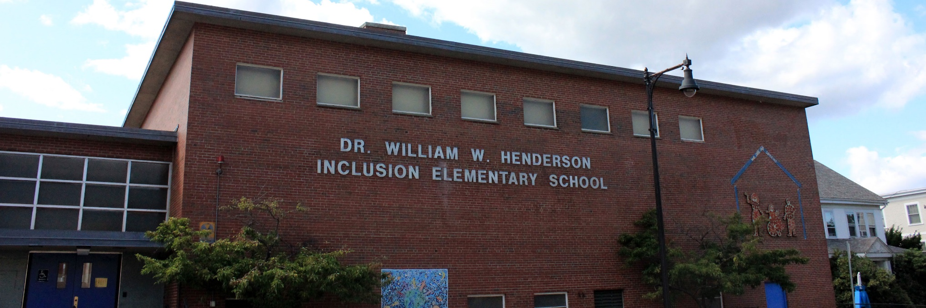
Let’s Watch
William Henderson School
The William Henderson School is a fully inclusive school in Massachusetts. William Henderson was featured on the Today Show about 25 years ago for his advances in inclusive education as the principal of this school. William Henderson is blind.

Slide 19
https://www.youtube.com/watch?v=NRR67_osT-Q
Thasya-https://www.youtube.com/watch?v=t5NbTnGz_94

Slide 20
Inclusive Education Infrastructure
http://www.swiftschools.org/
Choose one area from the list below and read about it and come prepared to tell others in the class about that area….
Administrative Leadership
Multi-Tiered System of Support
Integrated Educational Framework
Family and Community Engagement
Inclusive policy Structure and Practice

Slide 21
What Are the Take-Aways?
What common themes in these films on inclusive education stood out for you?
What are the messages you think should be shared with others in your professional world?
What would you like to know more about?
Why does it matter?

Slide 22
So… What about
The continuum of placements?

Slide 23
Inclusive Education Factoring Success
Part 2

Slide 24

In An Inclusive School
Support services are provided to address the individual needs of all students
A high degree of collaboration among faculty and staff to deliver high quality educational services.
A high degree of achievement is expected for all students and teachers are prepared to meet challenges presented by diverse classrooms.

Slide 25
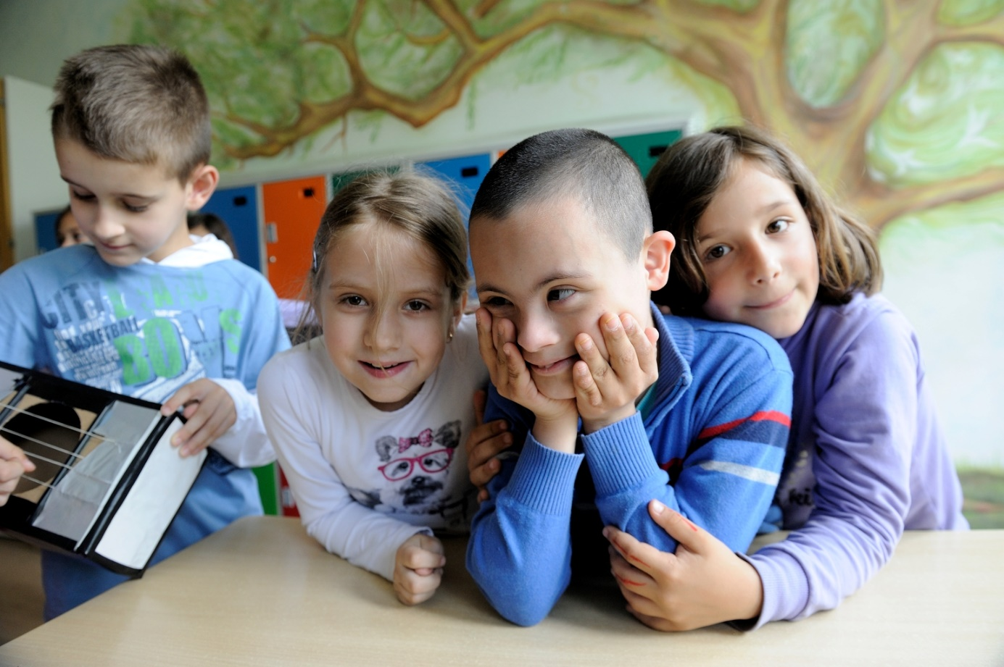
In An Inclusive School
Data are used to guide curriculum and instructional design
Peer interactions and relationships are facilitated
Positive Behavior Supports ensure that appropriate social skills are taught
Students have communication systems

Slide 26

What Contributes to a Supportive Classroom Environment?
Collaborative Teaching
Grouping Arrangements
Universal Design for Learning
Positive behavioral supports
Facilitating social relationships

Slide 27
Inclusion Means ….
ALL children learning in the same school and classrooms with the services and supports necessary to be successful there.
All children participating in all facets of school life
Academic instruction
Extra curricular activities
Routines and social opportunities

Slide 28
What Promotes Achievement for Students with Significant Cognitive Disabilities?
Effective Teaching Behaviors
High levels of engagement
Frequents opportunities to respond
High levels of success
Systematic Presentation
Immediate Feedback
McDonnell, 1998

Slide 29
What Makes an Inclusive School?
Buildings are safe, accessible, attractive, and without prejudice.
Classrooms are integrated, heterogeneous and responsive to different learning styles.
Opportunity is supported by the provision of necessary resources for all students.

Slide 30

Four Steps to Inclusion
Planning
Accommodating
Collaborating
Evaluating

Slide 31
Curriculum Accommodation
Material adaptation
Goal adaptation
Personal Support
Peers
Adults

Slide 32
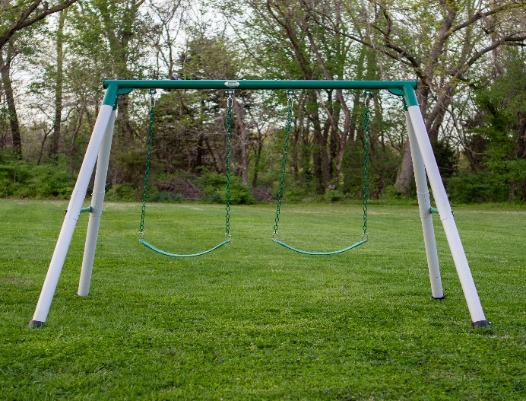
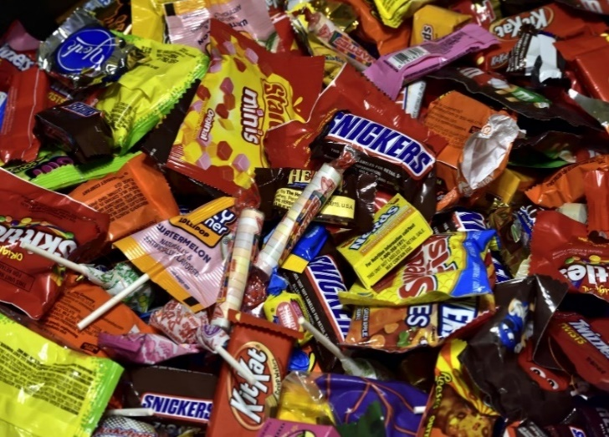
Kevin, Kindergarten
Likes
Dislikes
TV
Playing outside
Cracker snacks
Computer time
Swing
Circle time
Crowds
Most candy
Drastic changes
New situations
Strenuous exercise
Fast-paced activity

Slide 33
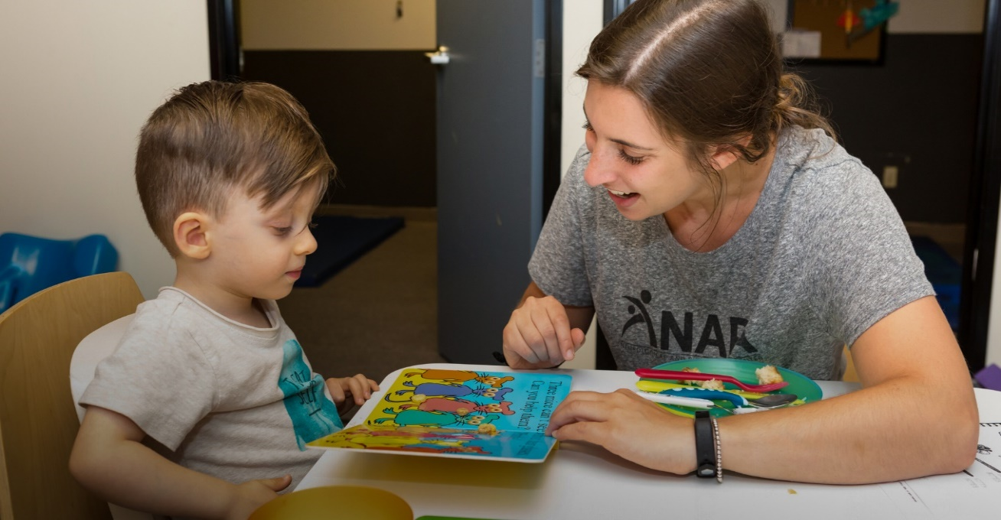

Goals for Kevin
Smooth transitions
Increase communication
Receptive /expressive language
Increase social interactions
Hand washing
Observes time limits
Improve fine motor

Slide 34
Classroom Activity Analysis
Classroom Routine/ Activity/ expectations | Appropriate for the Student? |  |  |  |  |  |  |  | What Adaptations? | Alternative Activities
Activity | AS IS |  | Materials |  | Goals |  | Personal Support
 | Y | N | Y | N | Y | N | Y | N
Free Play/Parent Talk Snack Circle Time calendar colors, seasons Theme Small Groups /Centers Outside play Story time/lunch prep Lunch Nap Quiet Play / personal care Free play/Outside

Slide 35
IEP Analysis
General Class Activities IEP Goals | Morning Greeting | Snack | Circle | Out door play or Gross motor | Theme Work groups | Lunch | Story time
Increase social greetings, farewells Use words to request/refuse Increase concept vocabulary Sustain communication Hand washing Improve fine motor Transition between activities smoothly

Slide 36
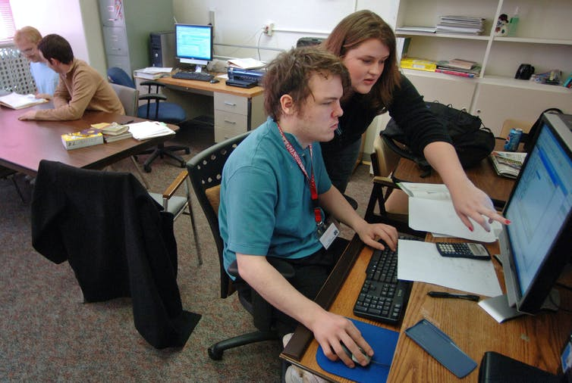
Cory Can….
Read signs, cooking terms, calendar words, names or family & friends
Write personal data & types w/ model
Add/subtract with number line
Use next dollar to make purchases
Work independently with personalized directions
Follow a schedule

Slide 37
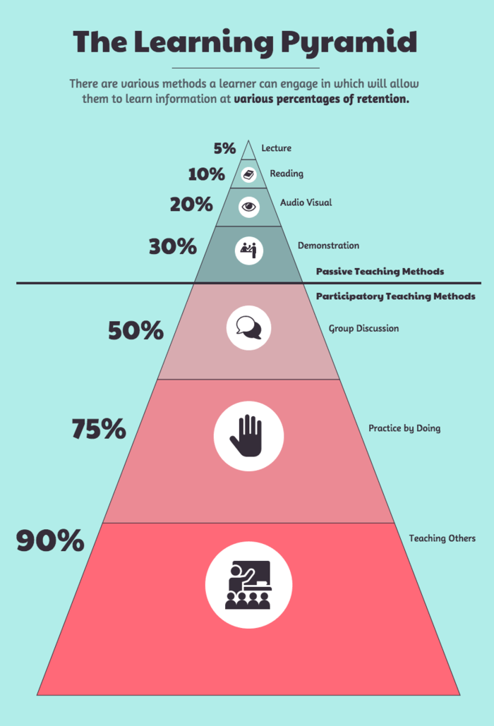
Cory Learns Best When
Presented with visual materials
Modeling
Personal directions
Repeated directions after processing time
Pre-teaching new content

Slide 38


Cory’s Likes & Dislikes
Fast Food
Wrestling on TV
Coke
Video games
Basketball
Cars
Movie Comedies
Crowds
Most candy
Drastic changes
New situations
Strenuous exercise
Fast-paced activity

Slide 39
Cory Needs Help With...
Organizing materials
Peer buddy to run errands
Interactions and becoming part of the group
Fine motor tasks – writing

Slide 40


Cory’s Annual Goals
Greet Others
Describe events, objects, interactions
Ask questions of others
Sustain communication with others.
Read to get information and/or follow instructions
Use Money
Use Telephone
Maintain appropriate social behaviors

Slide 41

Earth Science Expectations
Keep a science journal
Conduct experiments in cooperative group
Develop science vocabulary
Develop own experiment for science fair
Monitor the class weather station for 1 week
View Earth science video write a report
Conduct internet search on earth science topic

Slide 42

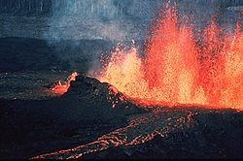
Earth Science
A volcano is the release of stored energy from below the surface of Earth, originating from radioactive decay and gravitational sorting in the Earth's core and mantle, and residual energy gained during the Earth`s formation
Wikipedia

Slide 43
Classroom Activity Analysis
Classroom Routine/ Activity/ expectations | Appropriate for the Student? |  |  |  |  |  |  |  | What Adaptations? | Alternative Activities
Activity | Which is |  | Materials |  | Goals |  | Personal Support
 | Y | N | Y | N | Y | N | Y | N
Keep a science Journal Conduct experiments with Group Develop vocabulary Formulate inquiry for science fair Write a re port about an earth science video Monitor the Weather Station Conduct internet search with key vocabulary

Slide 44
Makes the daytime. All the planets go around the sun.
www.nasa.com

Slide 45


Cory’s Schedule
Reading
Physical Education
Earth Science
Math
Computer Application
Home Economics

Slide 46
IEP Analysis
General Class Activities IEP Goals | Language Arts | PE | Earth Science | Computer Workshop | Read Aloud | Math | Science Social Studies
Greet Others Describe events, Objects etc. Ask questions Sustain communication Read for information Follow directions Procedures Solve problems

Slide 47
Circles of Support
Paid to be in your life
Social Networks
Relationships

Slide 48
Resources
http://www.pbs.org/parents/inclusivecommunities/inclusive_education.html
http://www.urbanschools.org/professional/tools/annotations_resource_guide.pdf
http://www.urbanschools.org/professional/mod_3/academy_3.html

Slide 49
Myth or Truth?
Inclusion is about building school communities where all children are welcomed, accepted, and successful.
Inclusion means that students with disabilities spend 100% of their school day in general education classrooms.
Inclusion is an initiative related to students with severe disabilities only.

Slide 50
Myth or Truth?
While not an academic goal, friendship is an important school outcome.
The people who experience the most anxiety in the change to inclusion are the classmates, they are the biggest barriers.
Inclusion means the same as mainstreaming and refers to “dumping” students with disabilities in general education.

Slide 51
Myth or Truth?
Initially, designing an inclusive program, like any other change, requires new learning and is therefore inefficient and requires additional time.
The excessive need to plan and meet decreases over time.
IF children are excluded from school communities, they are at risk for a lifetime exclusion from the community at large.

